Slide 1
DBS152 – Introduction to Database
Week 1: Lesson 2

Slide 2
Introduction to DBMS concepts Lesson 2: Database Structures and Querying

Slide 3
Objective:
By the end of this lesson, you will be able to:
Differentiate between SQL and NoSQL databases.
Understand key database concepts such as tables, relationships, and indexing.
Learn about database query languages and their role in data retrieval.

Slide 4
Content
SQL vs. NoSQL Databases
Key Database Concepts
Database Query Languages
Summary
Activity

Slide 5
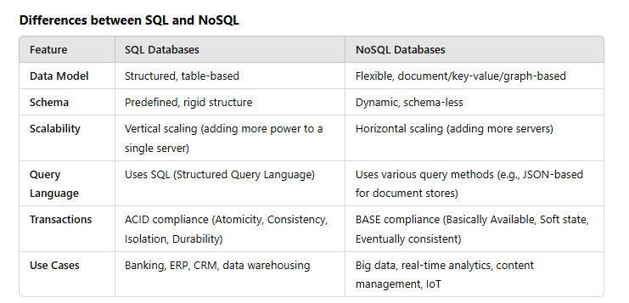
1. SQL vs. NoSQL Databases
Databases are categorized into two major types: SQL and NoSQL. Understanding the differences helps in selecting the appropriate database for specific applications.

Slide 6
Advantages of SQL and NoSQL
SQL Advantages:
Strong consistency and reliability.
Well-suited for complex queries and structured data.
Standardized query language (SQL).
NoSQL Advantages:
Highly scalable and suitable for large datasets.
Flexible schema, allowing easy modifications.
Optimized for high-speed transactions and distributed environments.

Slide 7
When to Use SQL vs. NoSQL
Use SQL when:
The data structure is well-defined with relationships.
Transactions require strong consistency.
The application needs complex queries and reporting.
Use NoSQL when:
Handling large volumes of unstructured or semi-structured data.
Scaling horizontally is a priority.
Real-time applications demand high-speed data access.

Slide 8
2. Key Database Concepts
Tables
In SQL databases, data is stored in tables.
A table consists of rows (records) and columns (fields).
Each table has a unique name and is part of a schema.

Slide 9
Schemas
A schema defines the structure of the database, including tables, columns, and relationships.
SQL databases require predefined schemas, while NoSQL databases offer flexibility in structure.

Slide 10
Relationships
SQL databases use relationships to link data across tables.
Types of relationships:
One-to-One (1:1): A record in one table corresponds to exactly one record in another.
One-to-Many (1:M): A record in one table relates to multiple records in another.
Many-to-Many (M:N): Multiple records in one table relate to multiple records in another, often requiring a junction table.

Slide 11
Indexing
Indexing improves database performance by allowing faster data retrieval.
Common types of indexes:
Primary Index: Automatically created on primary keys.
Unique Index: Ensures uniqueness of a column’s values.
Composite Index: Covers multiple columns.
Full-text Index: Used for searching text-based data.

Slide 12
3. Database Query Languages
SQL (Structured Query Language)
A standard language for managing relational databases.
Key operations:
Data Querying: SELECT
Data Modification: INSERT, UPDATE, DELETE
Schema Management: CREATE TABLE, ALTER TABLE, DROP TABLE
Permissions: GRANT, REVOKE

Slide 13
Example Query:
SELECT name, age FROM employees WHERE age > 30;

Slide 14
NoSQL Querying
No standard language; varies by database type.
Common querying methods:

Slide 15
Document Stores (MongoDB): Uses JSON-like queries.
db.users.find({ "age": { "$gt": 30 } })

Slide 16
4. Summary
SQL databases are best for structured data with strong relationships and require ACID compliance.
NoSQL databases offer flexibility and scalability for large-scale, real-time applications.
Understanding key database concepts (tables, schemas, relationships, indexing) is crucial for database design and optimization.
Query languages such as SQL and NoSQL methods enable data retrieval and manipulation.

Slide 17
5. Activity
1. What are two advantages of using a NoSQL database over an SQL database?
2. What is an index in a database, and why is it important?
3. Write an SQL query to retrieve all employees whose salary is greater than 50,000.
4. Explain the ACID properties in SQL databases.
5. Name two types of NoSQL databases and provide an example of each.

Slide 18
solution
1. Two advantages of NoSQL over SQL:
NoSQL databases scale horizontally, making them suitable for big data applications.
They allow flexible schemas, making it easier to store unstructured or semi-structured data.
2. What is an index and why is it important?
An index is a database structure that improves the speed of data retrieval.
It works like an optimized lookup table, reducing the time needed for queries.

Slide 19
3. SQL query to retrieve employees with a salary greater than 50,000:
SELECT * FROM employees WHERE salary > 50000;

Slide 20
4. ACID properties in SQL databases:
Atomicity: Ensures transactions are all-or-nothing.
Consistency: Guarantees data remains valid after transactions.
Isolation: Ensures transactions do not interfere with each other.
Durability: Ensures data is permanently stored even after system failures.

Slide 21
5. Two types of NoSQL databases and examples:
Document-based NoSQL: MongoDB.
Key-Value Store NoSQL: Redis.

Slide 22



